Slide 1
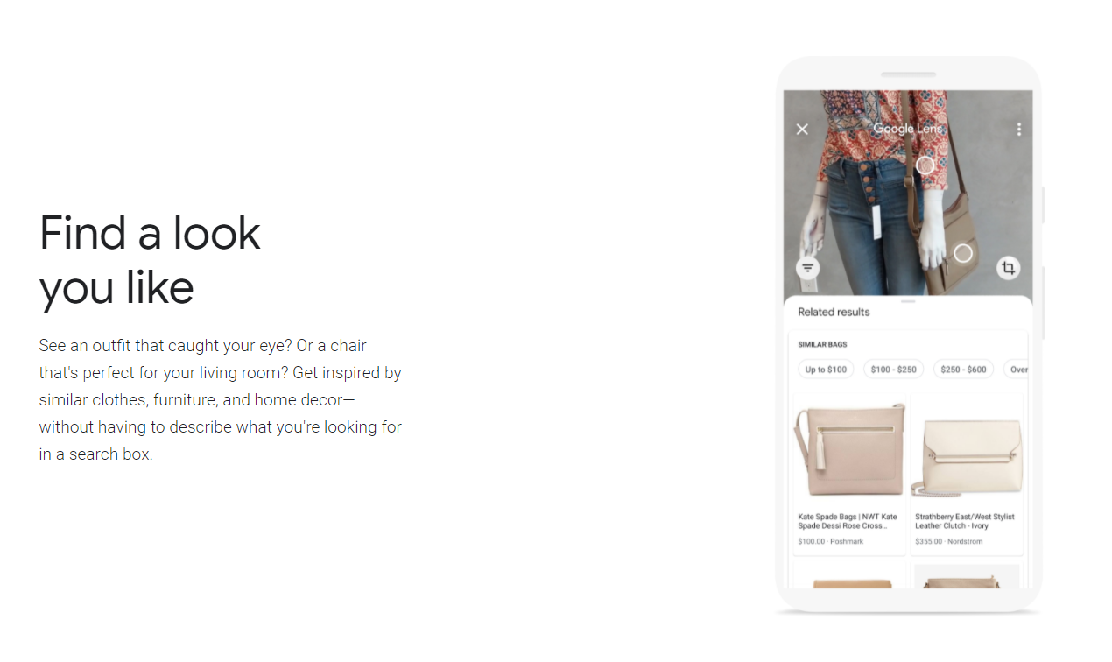
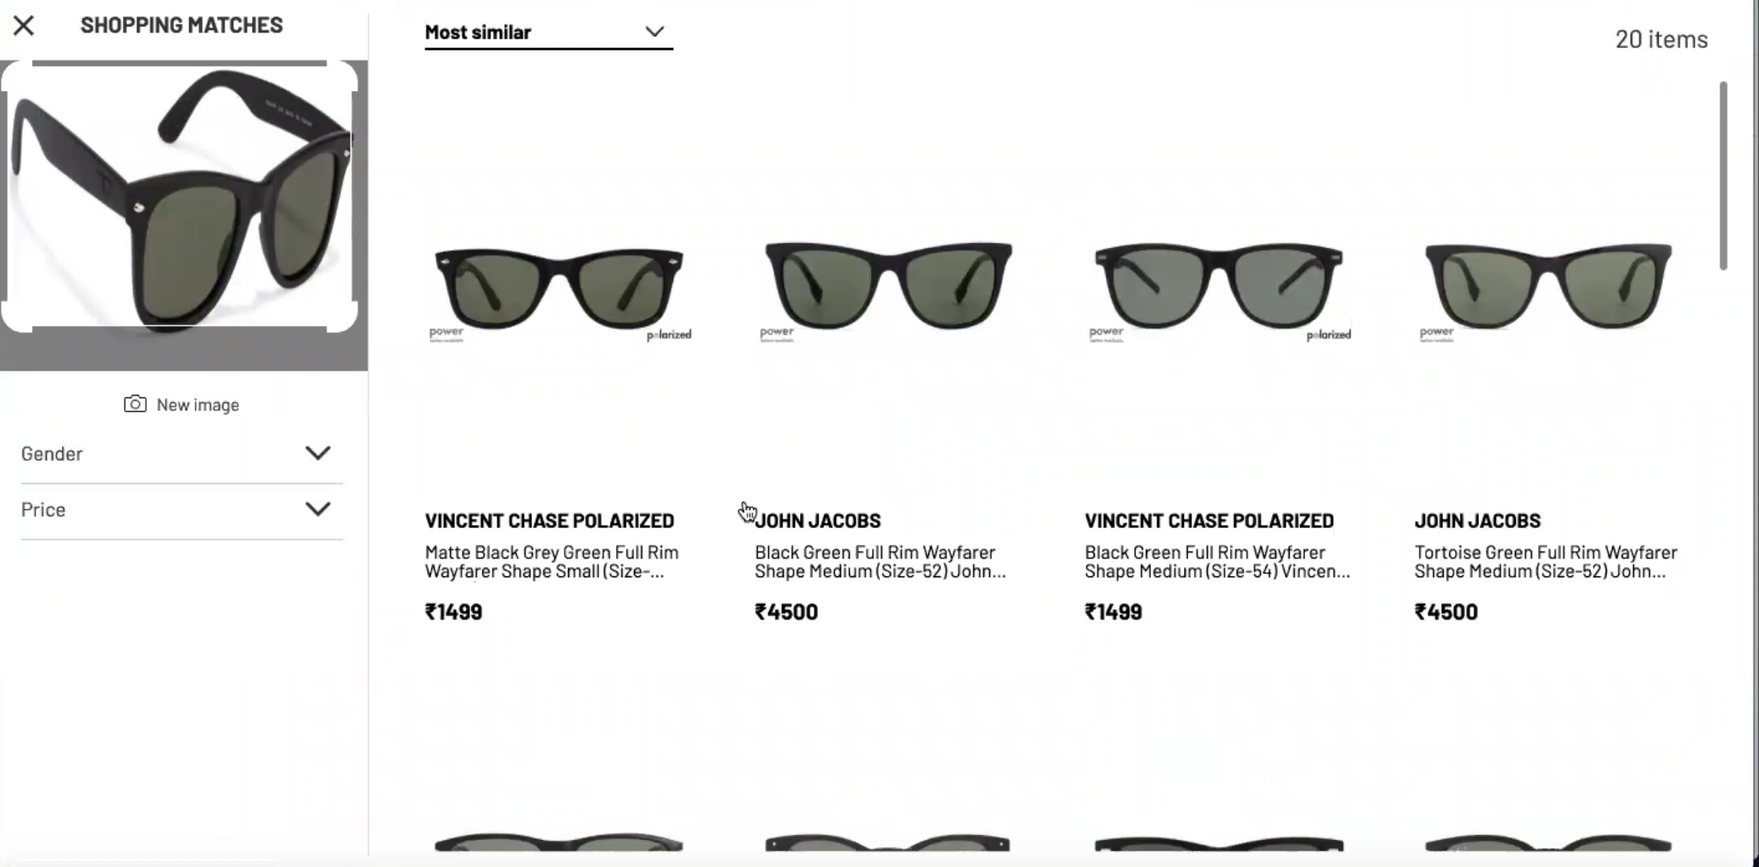
Motivation and Literature Review
Website: Lenskart
Google Lens
Literature Review:
Image Classification for E-Commerce — Part I- https://towardsdatascience.com/product-image-classification-with-deep -learning-part-i-5bc4e8dccf41
Building a Reverse Image Search Engine: Understanding Embeddings- https://www.oreilly.com/library/view/practical-deep-learning/9781492034858/ch04.html
Srikanth Tammina (2019); Transfer learning using VGG-16 with Deep Convolutional Neural Network for Classifying Images; International Journal of Scientific and Research Publications (IJSRP) 9(10) (ISSN: 2250-3153), DOI: http://dx.doi.org/10.29322/IJSRP.9.10.2019.p9420

Slide 2
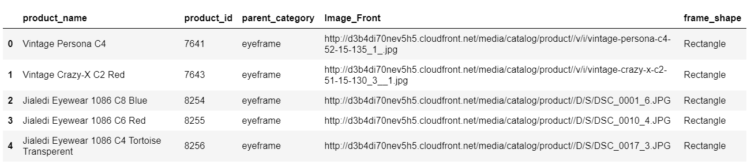
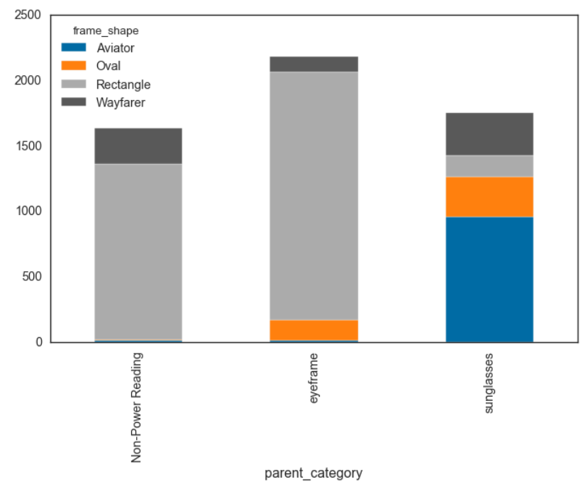
Dataset Description and Preprocessing
Features of the dataset:
Product_name
Product_id - unique product id
Parent_category - categorical column
Image_Front - url of the image
frame_shape - categorical column
Dataset Size: 5570
Pre-processing :
Image_to_ array (224,224,3)
VGG 16
Features Storage (5570,7,7,512)

Slide 3
Methodology
Input Image
Model
10 Similar Images
Input image
Object Detection (currently not included)
VGG 16 features (Product ID v/s features)
ANN model (Category & Shape prediction)
Cosine similarity scores (Subset: predicted category & shape)
Top10 Images
(API)

Slide 4
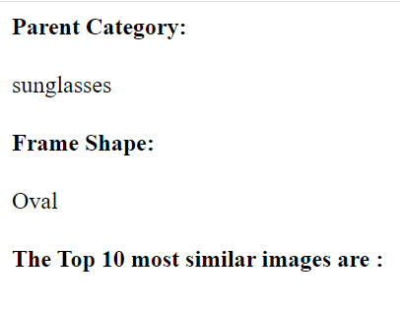
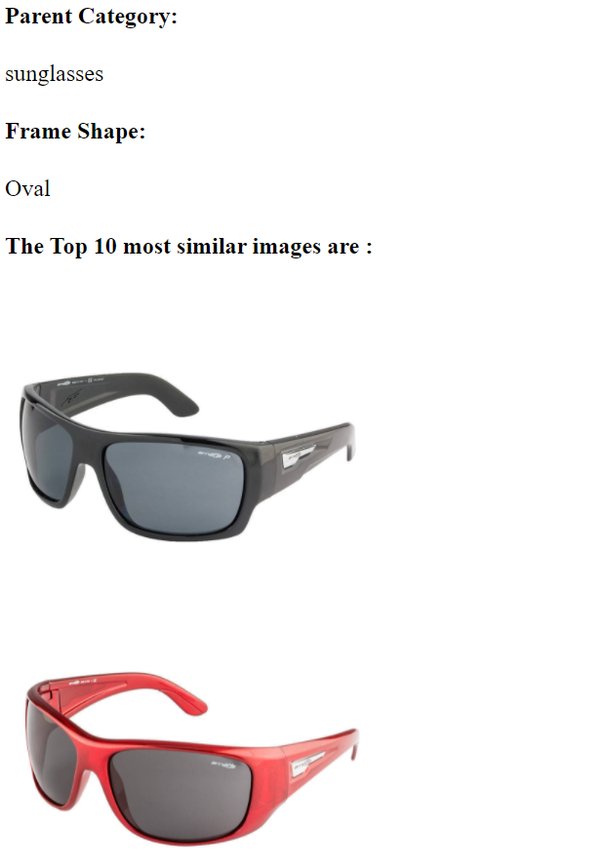
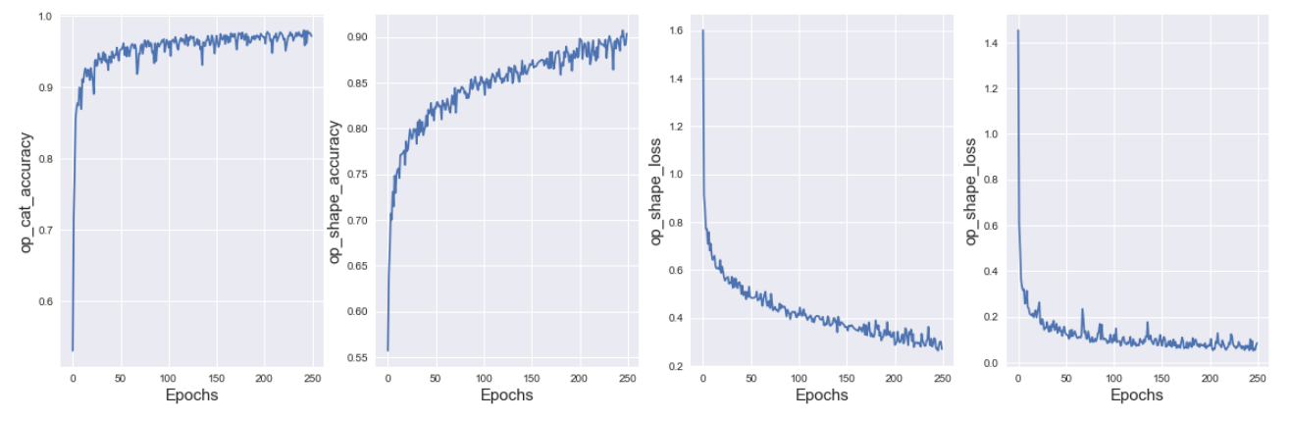
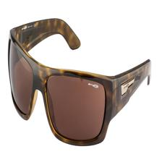
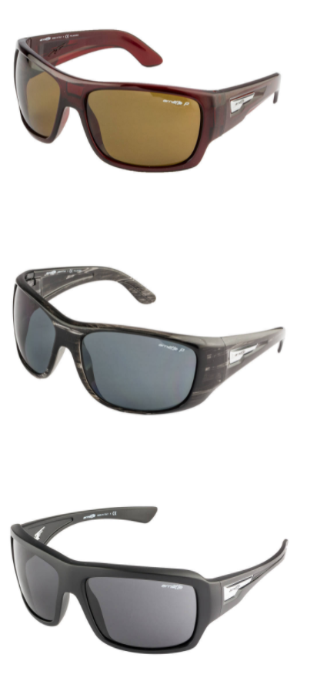
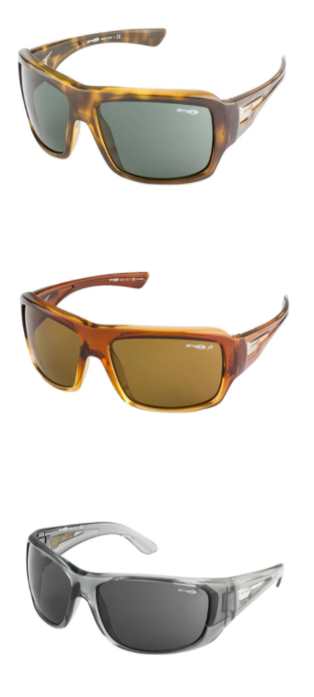
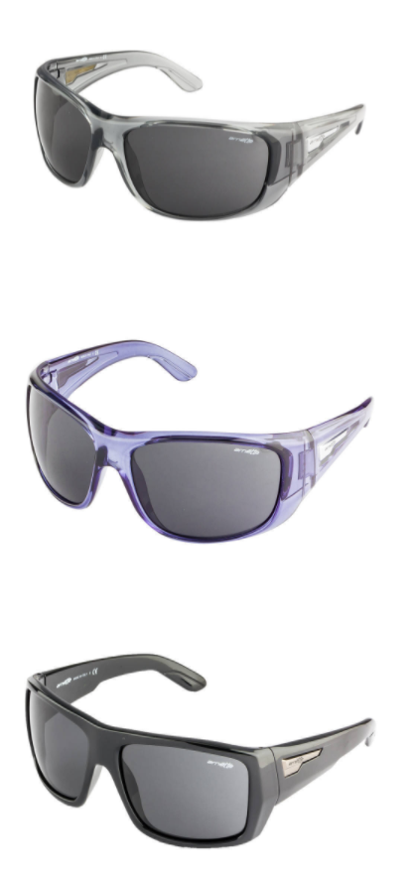
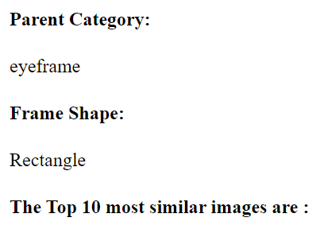
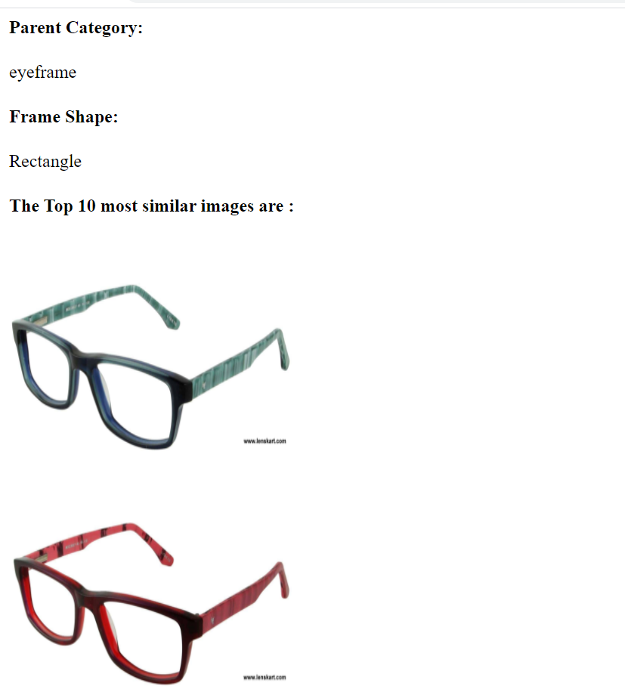
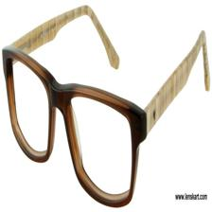
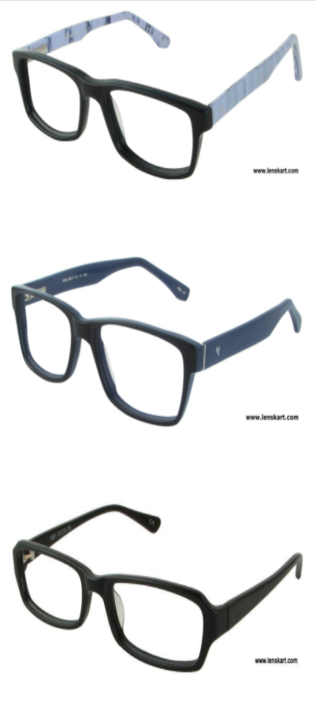
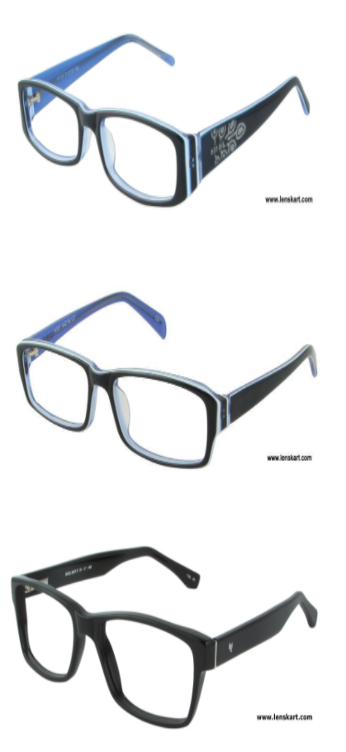
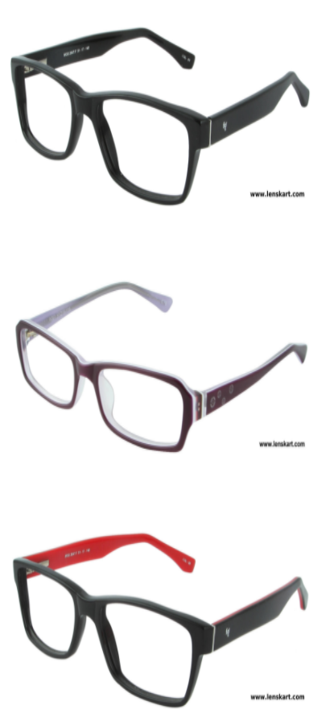
Results and Team Contribution

